Slide 1


Slide 2

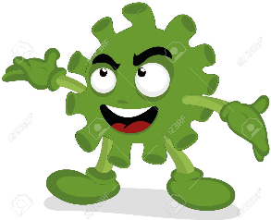

‘Twas late in ‘19 when the virus began
Bringing chaos and fear to all people, each land.
People were sick, hospitals full,
Doctors overwhelmed, no one in school.

Slide 3
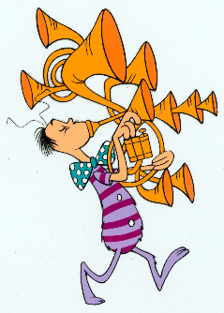
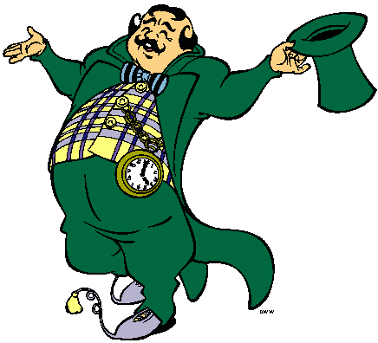



As winter gave way
to the promise of spring,
The virus raged on,
touching peasant and king.
People hid in their homes
from the enemy unseen.
They YouTubed and Zoomed,
social-distanced, and cleaned.

Slide 4


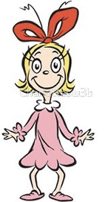
April approached and
churches were closed.
“There won’t be an Easter,”
the whole world supposed.
“There won’t be church services,
and egg hunts are out.
No reason for new dresses
when we can’t go about.”

Slide 5

Holy Week started, as bleak as the rest.
The world was focused on masks and on tests.
“Easter can’t happen this year,” it proclaimed.
“Online and at home, it just won’t be the same.”

Slide 6

Maundy Thursday, Good Friday,
the days came and went.
The virus pressed on;
it just would not relent.
The world woke on Sunday
and nothing had changed.
The virus still menaced,
the people, estranged.

Slide 7

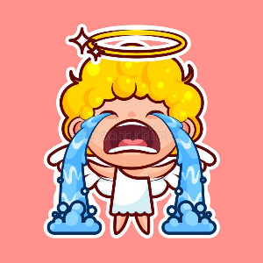
“Pooh pooh to the saints,”
the world was now grumbling.
“They’re finding out now
that no Easter is coming.”
“They’re just waking up!
We know just what they’ll do!
Their mouths will hang open
a minute or two,
And then all the saints, from Agnes to Zach,
will all cry boo-hoo, feeling under attack.”

Slide 8


“That noise,” said the world,
“will be something to hear.”
So it paused and the world
put a hand to its ear.
And it did hear a sound
coming through all the skies.
It started down low,
then it started to rise.

Slide 9

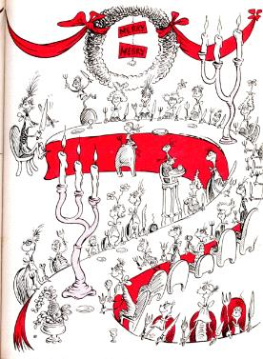
But the sound wasn’t depressed.
Why, this sound was triumphant!
It couldn’t be so!
But it grew with abundance!
The world stared around,
popping its eyes.
Then it shook! What it saw
was a shocking surprise!

Slide 10
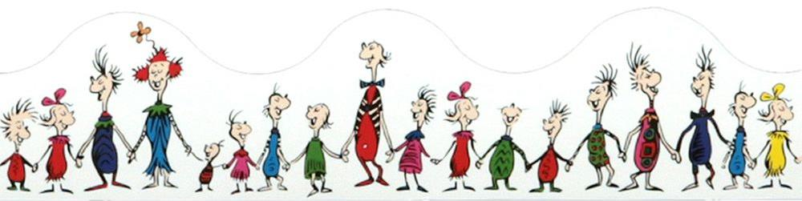
Every saint in all nations, the tall and the small,
Was celebrating Jesus in spite of it all!
It hadn’t stopped Easter from coming! It came!
Somehow or other, it came just the same!

Slide 11


And the world with all people
now self-quarantees
Stood puzzling and puzzling.
“Just how can this be?”
“It came without bonnets,
it came without bunnies,
It came without egg hunts,
cantatas, or money.”

Slide 12

Then the world thought of something
it hadn’t before.
“Maybe Easter,” it thought,
“doesn’t come from a store.
Maybe Easter, perhaps, means a little bit more.”

Slide 13

And what happened then?
Well....the story’s not done.
What will YOU do?
Will you share with that one
Or two or more people
needing hope in this night?
Will you share your hope’s source
as we live through this fright?

Slide 14
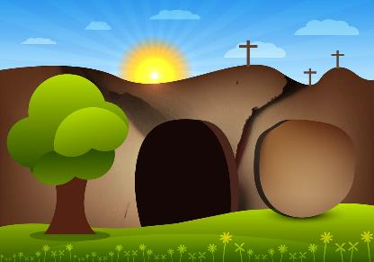

The churches are empty –
but so is the tomb,
And Jesus is victor
over death, doom, and gloom.
So this year at Easter,
let this be our prayer,
As the virus still rages
all around, everywhere.

Slide 15
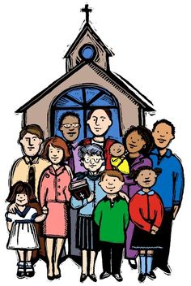
May the world see true hope
when it looks at God’s people.
May the world see the church
isn’t a building or steeple.
May the world find its faith
in Jesus’ graced resurrection,
May the world find true joy
in a time of dejection.

Slide 16
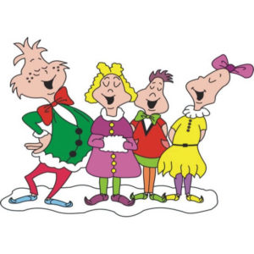
May 2020 be known
as the year of survival,
But not only that -
Let it start a revival
Of faith, hope, and love
in support of each other.
May love revive all,
Every sister and brother.

Slide 17

May our souls be strengthened
In this Easter way
And may all hearts worldwide
Grow three sizes today!

